Slide 1
IBM CAPSTONE PROJECT
COVID19 DATA ANALYSIS
By Debesh Roy
10-Sep-2020

Slide 2
Index
  Introduction
  Background
  Data
  Visualization
Applying Data Science using Python & Machine learning to identify the Covid19 trend across Globe

Slide 3
Introduction
As Covid19 is the one of the main discussion topics across Globe, wanted
to explore the World data and see how the graph is moving, either upward
or downward.
Well, probably all these are already available over net, but I just wanted to
go out of the common trend to follow the same kind of dataset to submit the
project report.
Point to be noted, this project and data analysis will give a fair knowledge
on the trend of the Covid19 pandemic situation across globe.

Slide 4
Background
Coronavirus disease (COVID-19) is an infectious disease caused by a newly discovered
coronavirus. Most people who fall sick with COVID-19 will experience mild to moderate
symptoms and recover without special treatment.
The virus that causes COVID-19 is mainly transmitted through droplets generated when an
infected person coughs, sneezes, or exhales. These droplets are too heavy to hang in the air,
and quickly fall on floors or surfaces. One can be infected by breathing in the virus if s/he is
within close proximity of someone who has COVID-19, or by touching a contaminated surface
and then own eyes, nose or mouth.
In this project we will try to find the trend of the various data, like World, Highest countries,
digging down further within a country and identify the county level trend.
We will use the data science mechanism to generate more information about the nearby medical
venues, which will help interested/impacted people to visit for consultation or medical assistance.

Slide 5
Data
The related information about Covid19 got downloaded from multiple websites, mentioned below:
World Master: https://covid.ourworldindata.org/data/ecdc/full_data.csv
USA State Master: https://covidtracking.com/api/v1/states/daily.csv
The above USA file is having state code, this needs to be joined to get the full state names.
US State Code & Name: https://worldpopulationreview.com/states/state-abbreviations
US State & County Master: https://raw.githubusercontent.com/nytimes/covid-19-data/master/us-counties.csv
We also downloaded the World Countries json and US States json from https://github.com

Slide 6
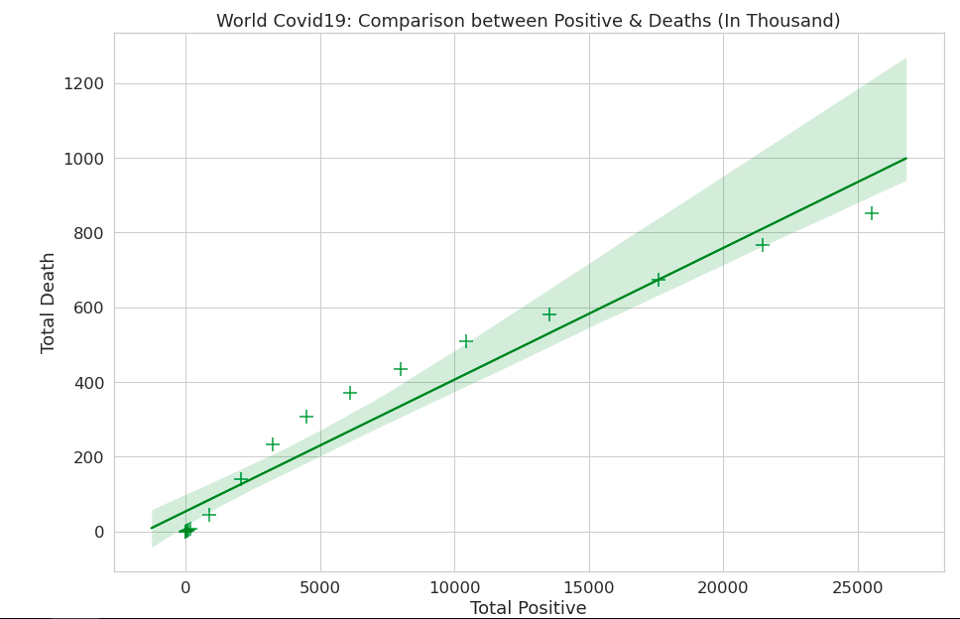
Visualization
Used Seaborn libries to compare between total Positive and Death counts

Slide 7
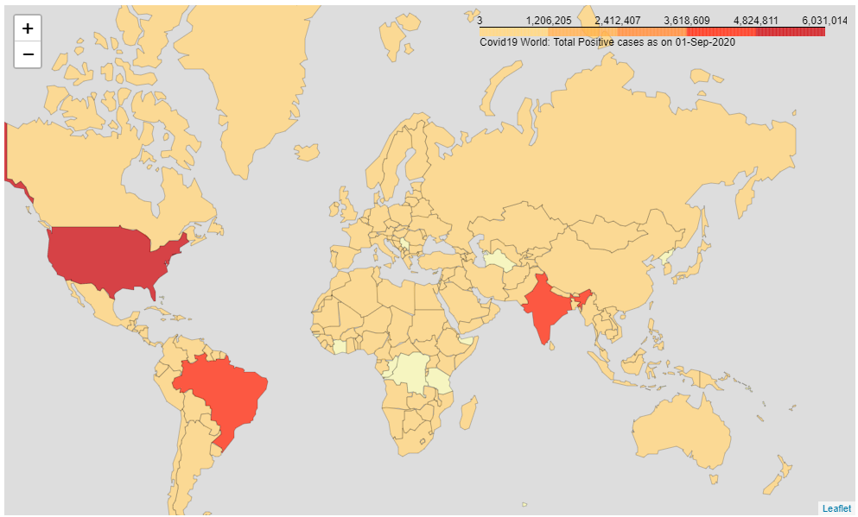
Visualization…..continued
Folium map to represent the World impact

Slide 8
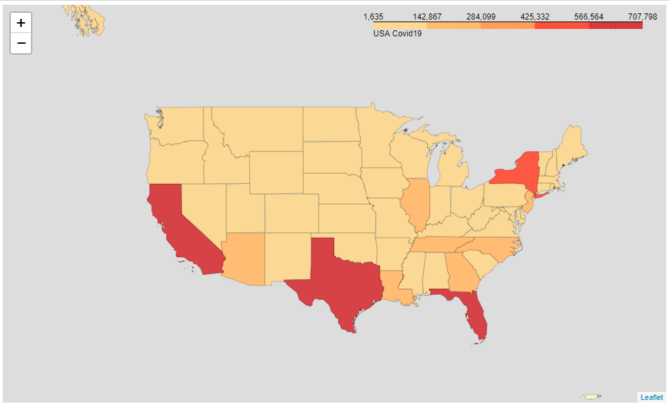
Visualization…..continued
Drillingf down further in US state level

Slide 9
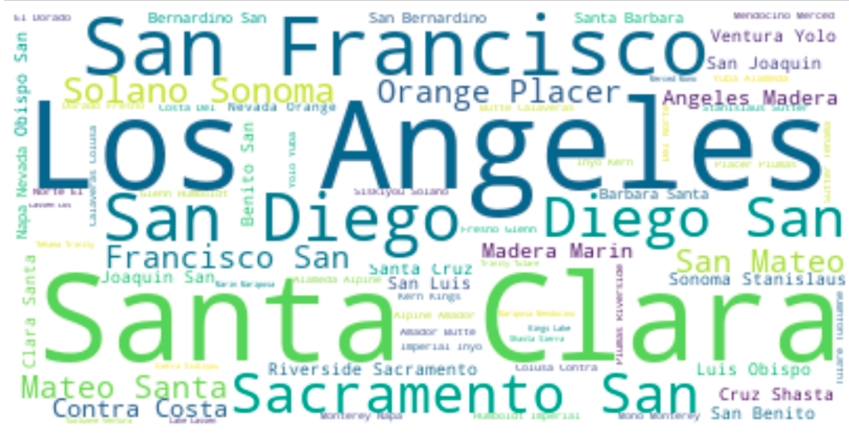
Visualization…..continued
Used Word Cloud to display the county level impact for CA

Slide 10
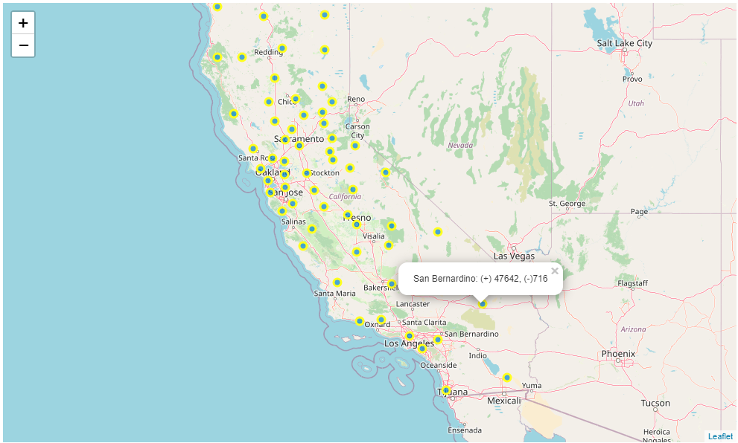
Visualization…..continued
As CA is having highest positive count, tracking the individual county

Slide 11
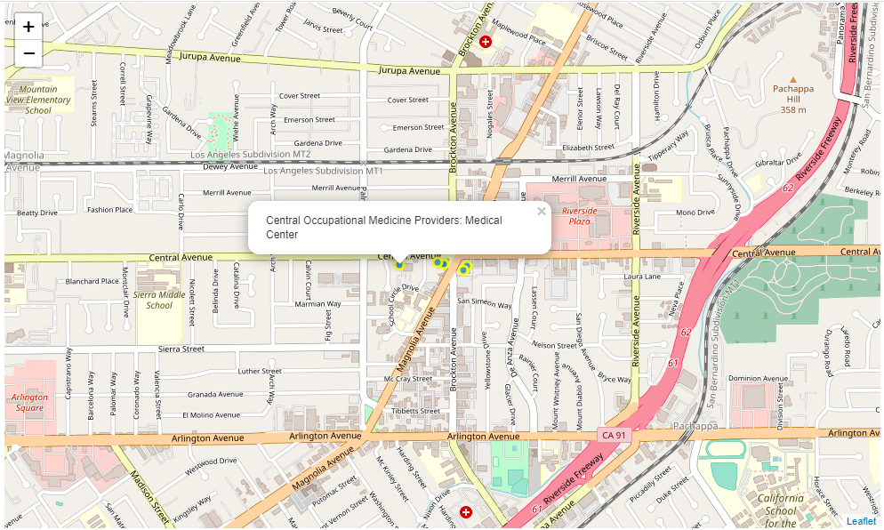
Visualization…..continued
As within CA Riverside county is having maximum positive number,
lets try to figure out what are the Medical facilities available

Slide 12


